Slide 1
Applications of OBI to Functional Genomics Data Annotation and Integrative Tools for Protozoan Parasite Research
Jie Zheng & Chris Stoeckert
Center for Bioinformatics
University of Pennsylvania School of Medicine
2011 San Diego OBI workshop

Slide 2
Annotation of Functional Genomics Data Using OBI

Slide 3
Annotation of Functional Genomics Data
Large amount of functional genomics data from microarray experiments and now using high throughput sequencing
ArrayExpress – over 20,000 experiments
The MGED Society developed standards for microarray data including MAGE-TAB with associated terminology for meta-data annotation to meet the Minimal Information About a Microarray Experiment (MIAME )standard. The MGED Ontology (MO) classes were structured fields (e.g., Experiment Design) and provided instances for some fields (e.g., compound_based_treatment, nucleic_acid_extraction)
MO needed updating and restructuring. Moved to OBI instead. Focus on those terms that proved useful.
Survey the usage of the MO terms in over 16,000 functional genomics experiments stored in ArrayExpress
Commonly used MO terms (used in more than 10 experiments ) – around 250 terms

Slide 4
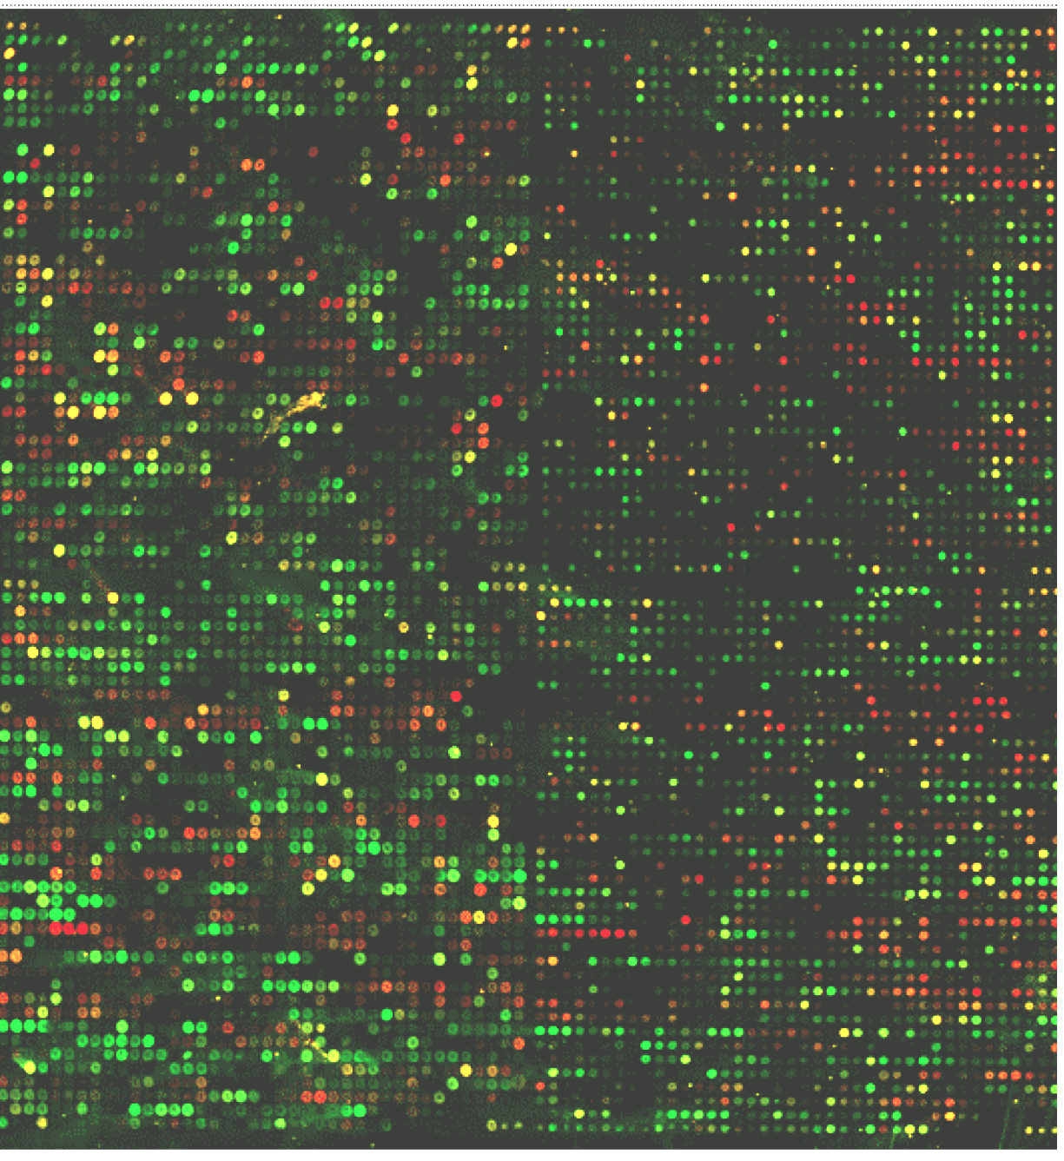
MIAME in a nutshell (ala Alvis Brazma)
Sample
genes
Sample
Experiment
Sample
Sample
Sample
RNA extract
Array design
RNA extract
RNA extract
RNA extract
RNA extract
labelled
nucleic acid
labelled
nucleic acid
hybridisation
array
labelled
nucleic acid
hybridisation
array
labelled
nucleic acid
hybridisation
array
labelled
nucleic acid
hybridisation
array
hybridisation
Microarray
Gene expression data matrix
Protocol
Protocol
Protocol
Protocol
Protocol
Protocol
normalization
Stoeckert et al.
Drug Discovery Today TARGETS 2004
integration
Notes:
For those not familiar with microarray experiments here are the essentials in a nutshell (thanks to Alvis). Have an experimental design for the different samples with certain characteristics and subjected to certain treatments. The samples are hybridized to arrays which have a certain set of reporters for genes on them. There are protocols for each of these components including scanning the hybridized array to generates an image of bound material, generating intensity values, and analyzing the data.

Slide 5
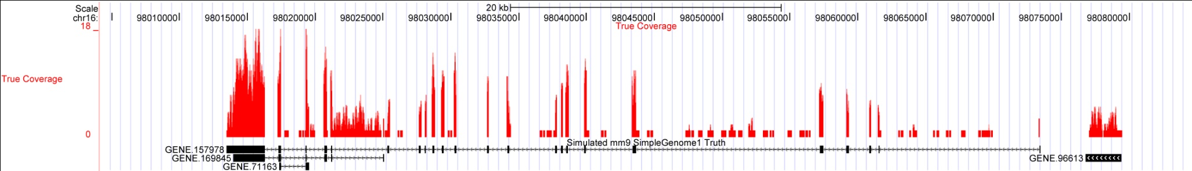
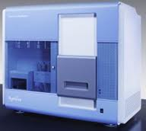
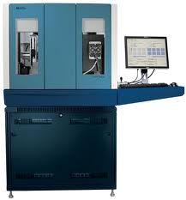
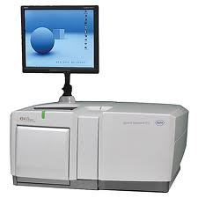
Sequencing is replacing array technology
Sample
genes
Sample
Experiment
Sample
Sample
Sample
RNA extract
Array design
RNA extract
RNA extract
RNA extract
RNA extract
@HWI-EAS266_0011:8:1:6:969#0/1
GTTTGCCNGTGTGTACGCTACCCCCTTCTTGTGTGTGTGTGTCT
+HWI-EAS266_0011:8:1:6:969#0/1
_abb`a[DZ`aabaa_a`b]___^^aa_`aa_a^a[\\aZTZVY
@HWI-EAS266_0011:8:1:7:1688#0/1
AAGATGANGGCAGGGTGCAAGATGGCAGGATGCAAGATGGCAGG
+HWI-EAS266_0011:8:1:7:1688#0/1
a`^ab`^D\a]a`b``b_bbbaabb^abaa``^a_^_aa\]_VR
@HWI-EAS266_0011:8:1:7:593#0/1
CAGTTCANTTCTCAGCACCACACTGGGATGCTCACACATGCCTG
+HWI-EAS266_0011:8:1:7:593#0/1
abbbb_VD[bbbba_`bbbbbbbbbbbaa_`bbaabaabb_aa_
@HWI-EAS266_0011:8:1:7:139#0/1
CATGGGGNATAATTGCAATCCCCGATCCCCATCACGAATGGGGT
+HWI-EAS266_0011:8:1:7:139#0/1
aab`[^YDY]Z\baa`aabaaaa`aa`a]aa```\aY]^\]ZVX
@HWI-EAS266_0011:8:1:7:1390#0/1
GAATAATNGAATAGGACCGCGGTTCTATTTTGTTGGTTTTCGGA
+HWI-EAS266_0011:8:1:7:1390#0/1
_U^b_`]D\__a_a`S```Y[a__]a\aa_`]`aTVZ__\HYVX
@HWI-EAS266_0011:8:1:7:1663#0/1
TGATGTTNGTGGCAATAATGGGGGTAGCGGCAATGGTGGCGGGG
+HWI-EAS266_0011:8:1:7:1663#0/1
a`[_X]\DQTZ[^YYa[[aXV[PZUUYSYBBBBBBBBBBBBBBB
labelled
nucleic acid
labelled
nucleic acid
hybridisation
array
labelled
nucleic acid
hybridisation
array
labelled
nucleic acid
hybridisation
array
labelled
nucleic acid
hybridisation
array
hybridisation
Microarray
Gene expression data matrix
Protocol
Protocol
Protocol
Protocol
Protocol
Protocol
normalization
integration
Notes:
Which machine?
Image calling version. What quality scores?
what genome/ transcriptome aligned to?
Add slide to indicate the different kinds of outputs: ChIP, CLIP, MeDIP,

Slide 6
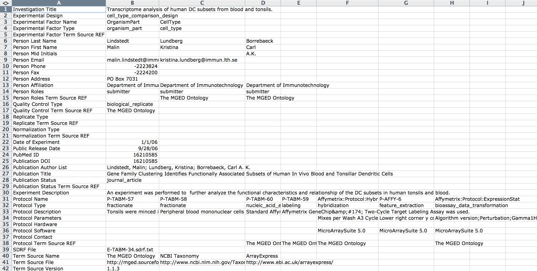
IDF file for E-TABM-34
IDF = Investigation Description Format
Notes:
Not only who did it, but what was their objective and what procedures did they use. Uses controlled vocabularies to facilitate searches

Slide 7
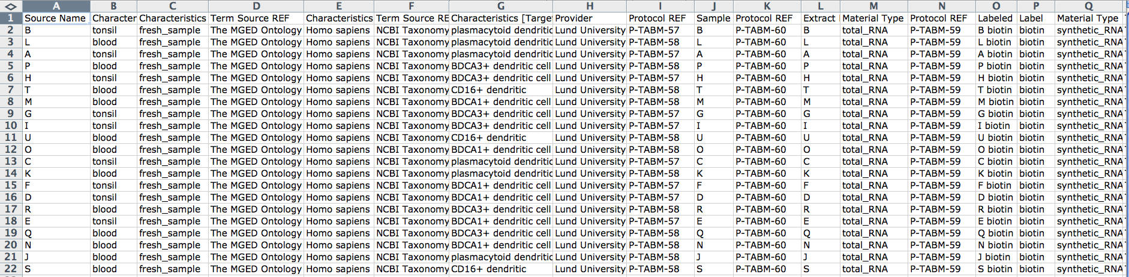
SDRF file for E-TABM-34
SDRF = Sample and Data Relationship Format
Notes:
Each row represents a sample and what was done with it.

Slide 8
Annotation Using OBI (Exp: E-MEXP-1979)
Field Name | MO terms | OBI terms | Status
Experimental Design | ex_vivo_design | ex vivo design | pending approval
 | genetic_modification_design | genetic modification design | pending approval
 | co-expression_design |  | deprecate
 | replicate_design | replicate design | in OBI
 | transcription profiling by array (EFO) | transcription profiling by array design | pending approval
Experimental Factor Type | genotype | allele information | pending approval
Person Roles | submitter | reporting party role | in OBI
Protocol Type | nucleic_acid_extraction | nucleic acid extraction | in OBI
 | specified_biomaterial_action | specimen creation | in OBI
 | pool | pooling specimen | in OBI
 | labeling | labeling | in OBI
 | hybridization | nucleic acid hybridization | in OBI
 | feature_extraction | feature extraction | in OBI
 | bioassay_data_transformation | data transformation | in OBI
Characteristics [Age] | Age | age since birth measurement datum | in OBI
Characteristics [InitialTimePoint] | InitialTimePoint
 | birth
Characteristics [Sex] | Sex | biological sex | in OBI (PATO)
 | male | male | in OBI (PATO)
Characteristics [BioSourceType] | BioSourceType | specimen | in OBI
 | fresh_sample | fresh specimen | in OBI
Characteristics [Genotype] | Genotype | allele information | pending approval
 | wild_type | allele wild type | pending approval
Characteristics [Organism] | Organism | organism | in OBI
Characteristics [OrganismPart] | OrganismPart | anatomical entity | in OBI
Characteristics [DevelopmentalStage] | DevelopmentalStage | life cycle stage | in OBI (UBERON)
Characteristics [GeneticModification] | GeneticModification | genetic transformation | in OBI
 | gene_knock_out | gene knock out | in OBI
Notes:
Most of experiments can be annotated using OBI

Slide 9
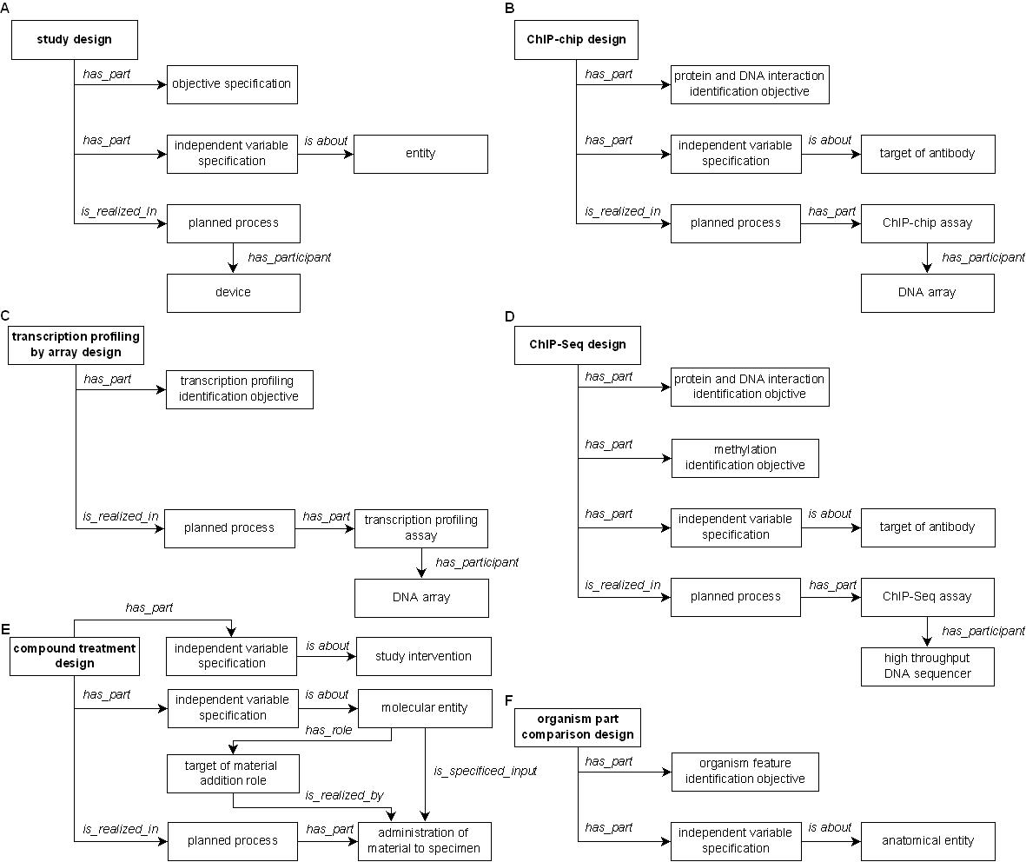
Design Pattern of Experimental Design Terms
Notes:
Bjoern: Study design that is_realized_in only (has_part some assay)
Hard to represent two relations in row, so draw planned process between two relations in the figure

Slide 10
Adding Required MO Terms into OBI
Thanks to the efforts of OBI developers, most of the commonly used MO terms are available in OBI
Still missing are:
genotype, allele, wild type
Under discussion
Experimental designs
Submitted to OBI tracker
https://sourceforge.net/tracker/?func=detail&aid=2902267&group_id=177891&atid=886178
All these terms have been added in an owl file for review
https://obi.svn.sourceforge.net/svnroot/obi/trunk/src/ontology/branches/ExpDesign.owl

Slide 11
Integrated Tools for Protozoan Parasite Research: Data Collection for EuPathDB Jie Zheng, Omar S. Harb, Christian J. Stoeckert Jr University of Pennsylvania

Slide 12
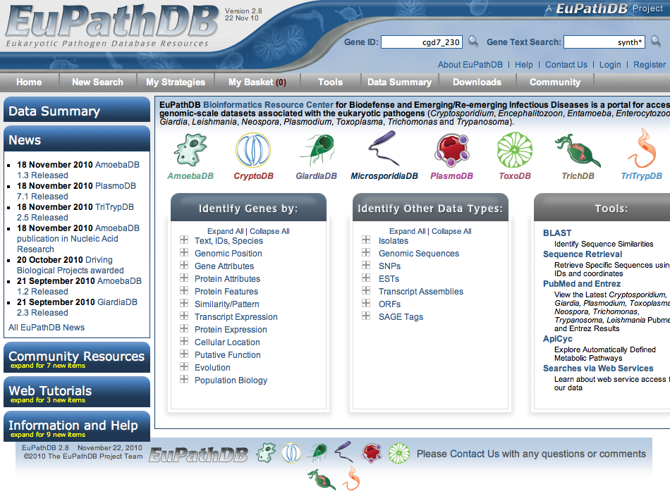
EuPathDB is a NIAID Bioinformatics Resource Center covering Eukaryotic Parasites
EuPathDB: a portal to eukaryotic pathogen databases.Aurrecoechea C, Brestelli J, Brunk BP, Fischer S, Gajria B, Gao X, Gingle A, Grant G, Harb OS, Heiges M, Innamorato F, Iodice J, Kissinger JC, Kraemer ET, Li W, Miller JA, Nayak V, Pennington C, Pinney DF, Roos DS, Ross C, Srinivasamoorthy G, Stoeckert CJ Jr, Thibodeau R, Treatman C, Wang H.Nucleic Acids Res. 2010

Slide 13
Background
EuPathDB
Public resource of protozoan parasite genomic and functional genomic data
To address the community’s needs and requirements, EuPathDB is starting to collect:
Isolate data
Geographic location from where isolate specimen collected
Host organism information: species, age, clinical information
Genetic manipulation and phenotype data
Mutation method
Effects of genetic modification on the parasite and on the location, function, and involvement in biological process of the resultant modified protein
These data are important for parasite epidemiology
and vaccine anti-parasitic drug research

Slide 14
Current Issues for EuPathDB
Isolate data
Need to import and integrate datasets from GenBank
But GenBank did not specify needed metadata for isolates
Manual curation required
Harmonize: enable Country of Origin queries: Tokyo -> Japan
Deconvolute descriptions in free text: HIV positive male patient
Genetic Manipulation and Phenotype data
Integrate phenotype data from other resources (GeneDB)
Allow individuals to submit phenotype data via the EuPathDB web site via User Comments on Gene pages
Either way these are free text descriptions limiting utility for data exploration
Notes:
Completeness of isolate data depending on submitter

Slide 15
Goal
Collect high quality data from scientists
Well structured
Consistently annotated using ontology terms
It will facilitate
Data integration
Data sharing
Data analysis
Data exploration
Issue complexity queries
Compare sequence data from Plasmodium isolates that are restricted to East Africa to those from West Africa
List genes that when knocked out result in a defect in parasite growth during the intraerythrocytic cycle
List genes fused to green fluorescent protein (GFP) that when expressed are located in the cell membrane

Slide 16
Isolate Submission Form
Isolate information
Target isolate information
Geographic location
Source organism samples information
or Environmental samples information
Sequence information

Slide 17
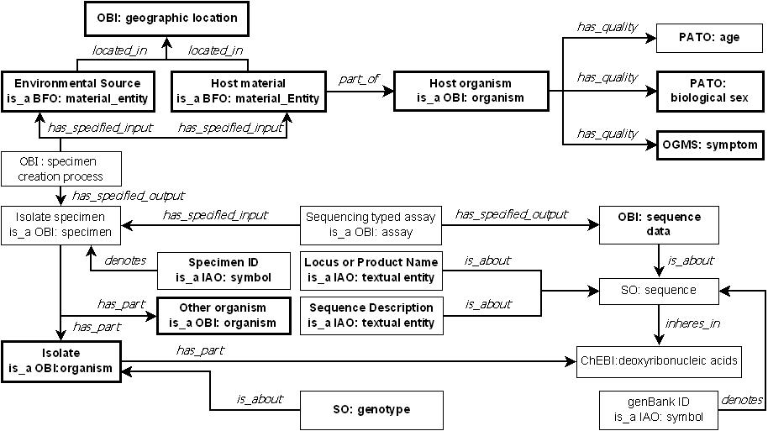
Ontology-based Representation of Isolate Data
The data collected in the submission form are in the bold font.
The fields require ontology terms are in thick border box.

Slide 18
Isolate Submission Form
Support multiple sequences submission
Notes:
Isolate ID: not clear what it refers to
Specimen id
target isolate id
sequence id (which it is in EuPathDB)
Sequence description: (required by GenBank)
complete sequence
partial sequence
partial cds
unknown

Slide 19
Genetic Manipulation and Phenotype Submission Form
Genetic Manipulation
Mutation method including selective marker, report if available
Mutation type (effect on gene function)
Phenotype data – impact of genetic manipulation on four possible observed features:
Quality of the organism
Cellular location of gene product
Molecular function of gene product
Biological process of gene product

Slide 20
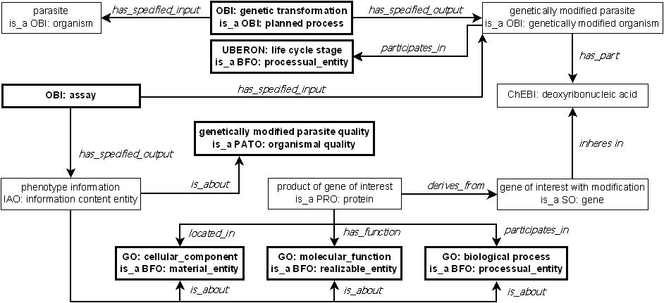
Ontology-based Representation of Genetic Manipulation with Resulting Phenotype Data
Use OPL for annotation
The data collected in the submission form are in the bold font.
The fields require ontology terms are in thick border box.
Ontology for Parasite Lifecycle (OPL) will be used in the annotation of life cycle stage

Slide 21
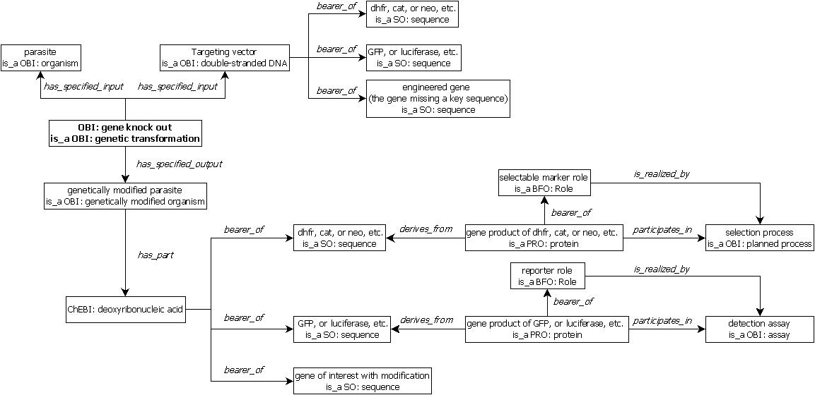
Ontology-based Representation of Genetic Manipulation – Gene Knock Out

Slide 22
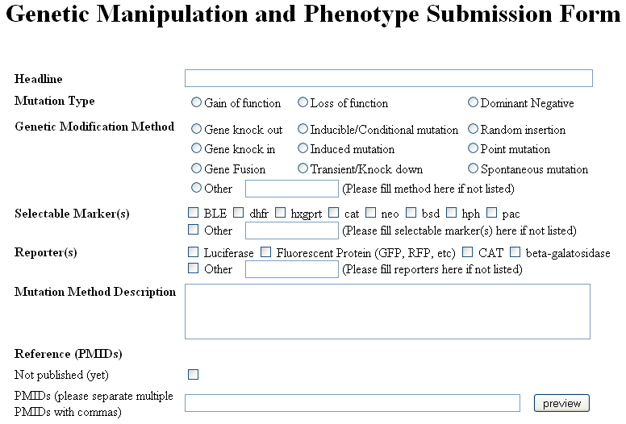
Genetic Manipulation Section

Slide 23
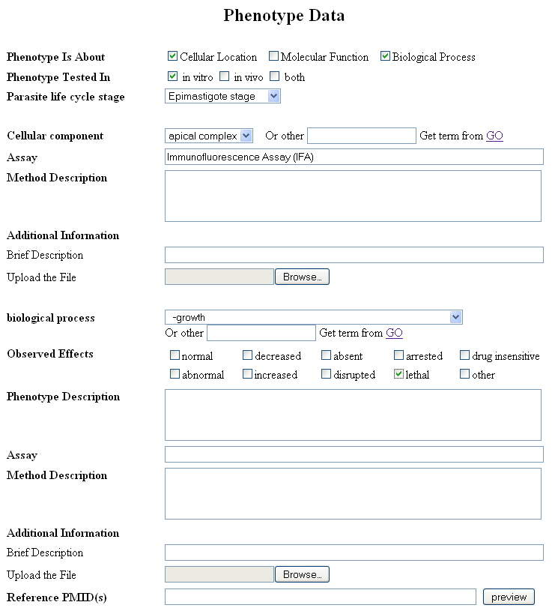
Phenotype Section
Cellular location
Biological process
Question:
What relation should use to link the quality
(PATO: organismal quality) such as:
PATO: lethal to biological process such as
GO: growth
Notes:
Would like to link Evidence code to OBI assay

Slide 24
Integrated Tools for Protozoan Parasite Research: Web Services Annotation Chaitanya Guttula, Alok Dhamanaskar, Yung Long Li, Sunny Suvineeth Vadlamudi, Rui Wang, John A. Miller, Jessica C. Kissinger University of Georgia Jie Zheng, and Christian J. Stoeckert, Jr. University of Pennsylvania

Slide 25
Background
Over 1000 bioinformatics web services
For biological data analysis, typically need more than web services
Example:
With a given protein sequence, find its evolutionary relationship to other protein sequences
Bioinformatics programs that need to be used:
BLAST
ClustalW
Phylip
Notes:
Many web services (over 1000) used to invoke bioinformatics programs.

Slide 26
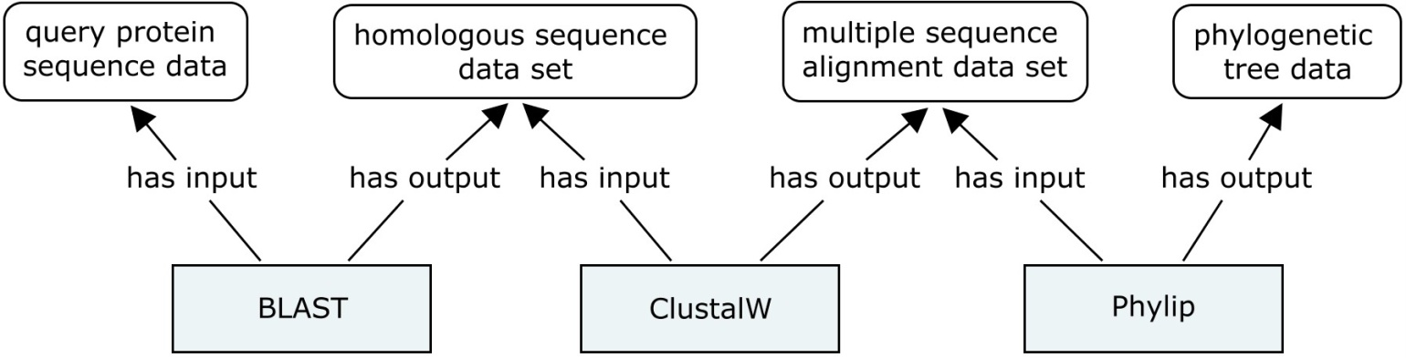
Web Services Workflow Creation
input/output
bioinformatics program
Challenges in workflow creation
Discover web service operation to invoke the bioinformatics programs running
Automatic format conversions
output format of one web service operation fit the input format of another web service operation
Semantic annotations help in automatic web services workflow creation

Slide 27
Semantics Annotation of Web Services
Web Service Description Language (WSDL)
An XML format language to describe the interface of a Web service
Operations offered by a Web service
Details of the operations including input, output, binding, etc.
WSDL-S/SAWSDL
Add ontology terms to describe web service operation
functionality
input
output
Notes:
WSDL-S/SAWSDL
More flexible and easy to use
WSMO, OWL-S/DAML-S, SWSO
Need to represent whole web services call using ontology terms
Web Services Description Language (WSDL) can specify the operations available through a web service and the structure of data sent and received but cannot specify semantic meaning of the data or semantic constraints on the data. This requires programmers to reach specific agreements on the interaction of web services and makes automatic web service composition difficult.
Semantic web services are built around universal standards for the interchange of semantic data, which makes it easy for programmers to combine data from different sources and services without losing meaning.

Slide 28
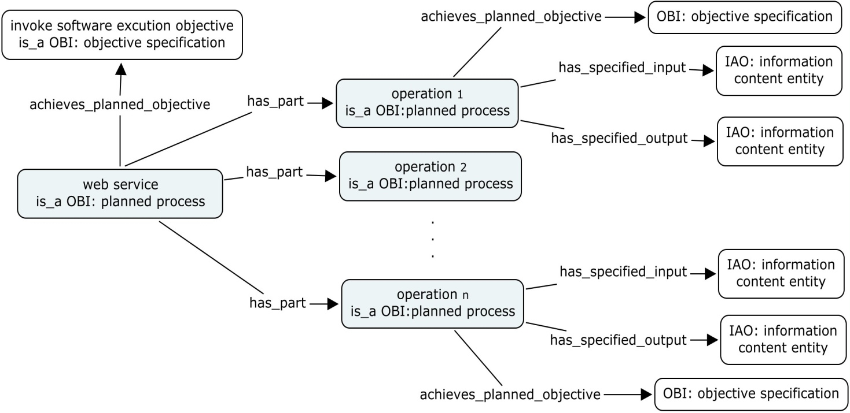
Enrichment of OBI for Web Services Annotation
Web Services
Functionality (objective specification)
Operations (planned process)
Inputs
Outputs

Slide 29
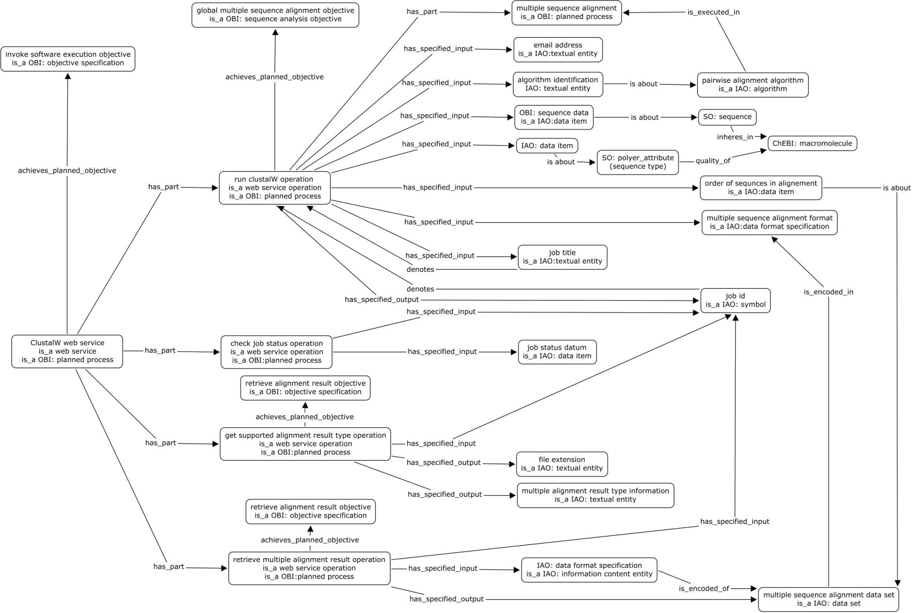
Ontology-based Representation of ClustalW

Slide 30
Required Terms for Web Services Annotation
OBI Tracker
https://sourceforge.net/tracker/?func=detail&aid=3031357&group_id=177891&atid=886178
Terms for Blast and ClustalW annotations added into an OWL file
https://obi.svn.sourceforge.net/svnroot/obi/trunk/src/ontology/branches/webService.owl

Slide 31
RadiantWeb Tool
Annotation Tool
Add extra annotations (OBI terms) to WSDL file
Discovery Tool
Similarity measures between web services based on ontology annotations including objective specification, input, and output
Suggestion Tool
Based on:
Semantic annotations
Relevant syntactic information
Notes:
Validate whether annotations using OBI terms help in workflow creation (discovery + suggestion)

Slide 32
Thank You

Slide 33
Validation – BLAST to ClustalW
Add ontology terms to annotation of functionality input, and output of web service operations
Annotations using ontology terms improve the performance of the web services suggestion and discovery
without ontology terms annotation
with ontology term annotation
Graph provided by Rui Wang, University of Georgia

